Slide 1
Integrating Python with SQL
By
Vishnu S
PONDICHERRY UNIVERSITY

Slide 2
Session Agenda
Day | Topics Covered (Full-Day Session)
Day 1 | - Introduction to Python and IDEs (PyCharm, Jupyter) - Variables, Data Types, Input/Output - Control Structures: if, else, elif, for, while - Functions: Definition, Parameters, Return Values - Hands-On: Calculator, conditional logic, and function-based programs
Day 2 | - Strings: Operations, Slicing, Built-in Methods - Lists, Tuples, Sets, Dictionaries: Methods & Use Cases - List Comprehension - Python File Handling: Reading/Writing CSV using csv and pandas - Hands-On: Data entry/search tools, CSV-based record system
Day 3 | - Object-Oriented Programming in Python: Classes and Objects - Structured Query Language (SQL): CREATE, INSERT, SELECT, UPDATE, DELETE - Integrating SQL with Python using sqlite3 or mysql.connector - Hands-On: CRUD operations on a student database using Python & SQL
Day 4 | - Data Visualization with matplotlib: Line Chart, Bar Chart, Pie Chart - Importing C++ Programs into Python using ctypes or pybind11 - Final Mini-Project: Real-world scenario combining CSV/SQL data with visualization - Project Presentation & Feedback Session

Slide 3
Python File Handling: Reading/Writing CSV using csv and pandas
CSV (Comma Separated Values) files are one of the most common formats for storing tabular data.
Python provides two powerful tools to handle CSV files:
The built-in csv module (lightweight and fast for basic tasks)
The external pandas library (rich features for data analysis)

Slide 4
Brief History of Python
Invented in the Netherlands, early 90s by Guido van Rossum
Named after Monty Python
Open sourced from the beginning
Considered a scripting language, but is much more
Scalable, object oriented and functional from the beginning
Used by Google from the beginning
Increasingly popular

Slide 5

Python’s Benevolent Dictator For Life
“Python is an experiment in how much freedom program-mers need. Too much freedom and nobody can read another's code; too little and expressive-ness is endangered.”
- Guido van Rossum

Slide 6
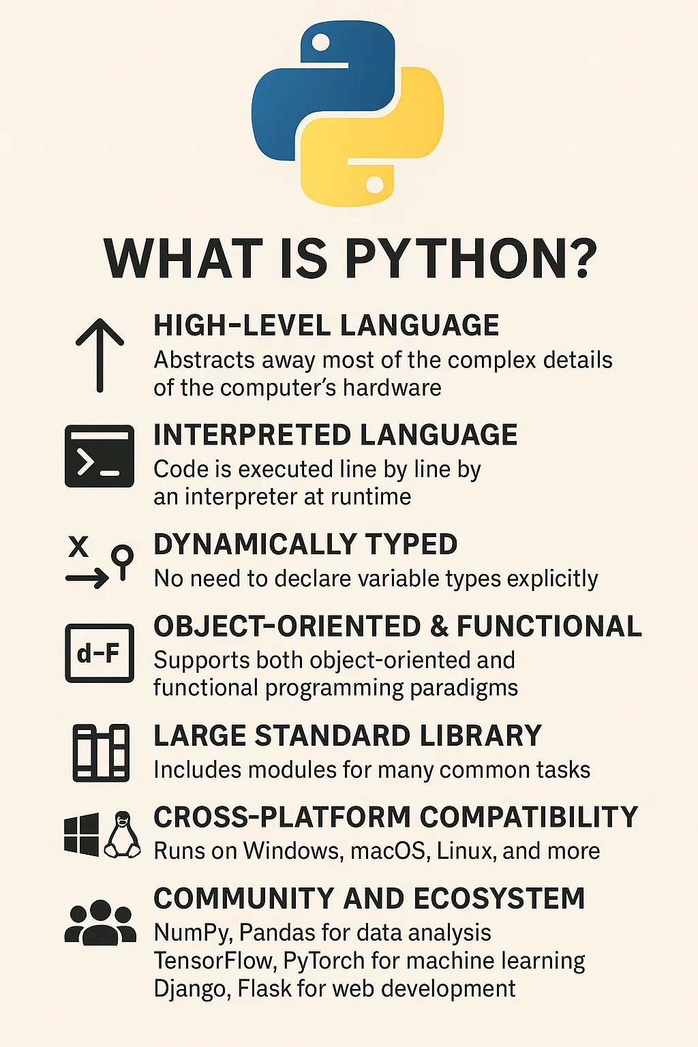


Introduction to Python and IDEs (PyCharm, Jupyter)
What is Python?
High-level, interpreted language
Applications: Web dev, Data Science, Automation, AI, IoT, etc.

Slide 7
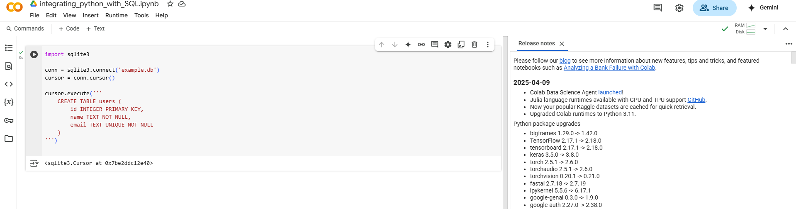
ONLINE Python compilers

Slide 8
Let’s Explore
📘 Python basics (syntax, loops, functions, etc.)
🔄 Data manipulation (Pandas, NumPy)
💾 File handling (CSV, JSON, Excel)
🗃️ Databases (Python + SQL)
📊 Data visualization (Matplotlib, Seaborn)
🧠 Machine learning (scikit-learn, TensorFlow)
🕸️ Web development (Flask, Django)
🤖 Automation & scripting
🧪 Projects & bootcamps
❓ Debugging or explaining your code

Slide 9
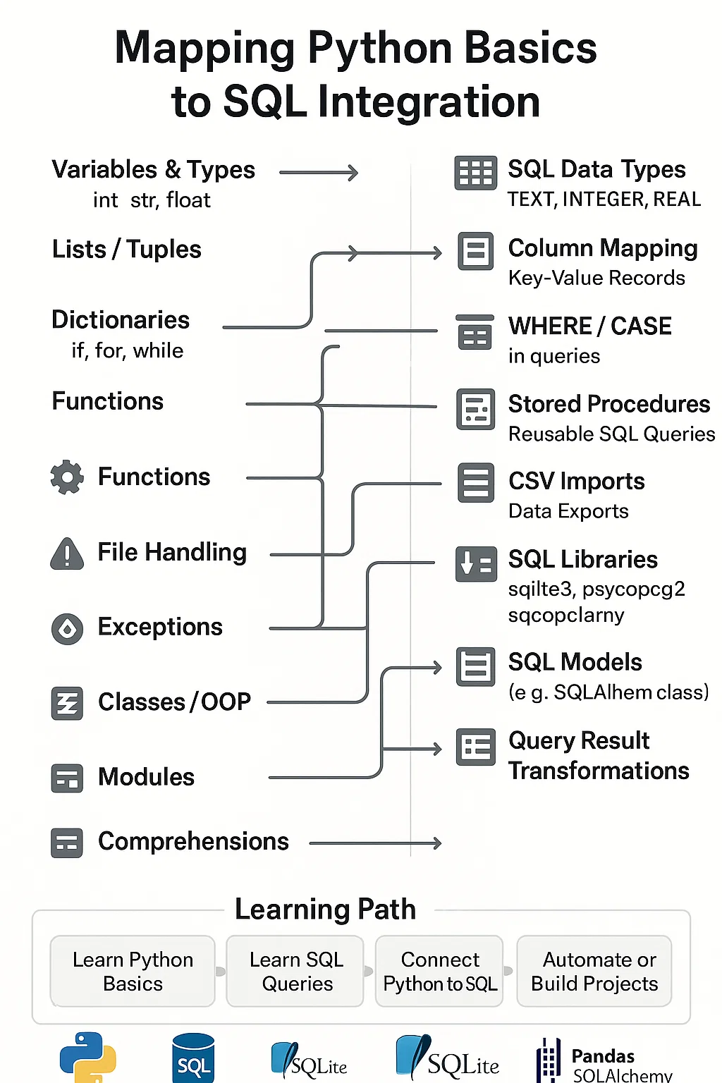
MIND-MAP

Slide 10
Data Type | Variable Example | Description | Example Program | Output
str | name = "Alice" | String (text) | name = "Alice“ print(name) | Alice
int | age = 25 | Integer (whole number) | age = 25 print(age) | 25
float | height = 5.6 | Floating point number | height = 5.6 print(height) | 5.6
bool | is_student = True | Boolean (True or False) | is_student = True print(is_student) | True
NoneType | nothing = None | Represents no value | nothing = None print(nothing) | None
list | fruits = ["apple", "banana", "cherry"] | Ordered, mutable collection | fruits = ["apple", "banana", "cherry"] print(fruits) | ['apple', 'banana', 'cherry']

Slide 11
Data Type | Variable Example | Description | Example Program | Output
tuple | coordinates = (10.0, 20.0) | Ordered, immutable collection | coordinates = (10.0, 20.0) print(coordinates) | (10.0, 20.0)
set | unique_numbers = {1, 2, 3, 4} | Unordered unique elements | unique_numbers = {1, 2, 3, 4} print(unique_numbers) | {1, 2, 3, 4} (order may vary)
dict | student = {"name": "Alice", "age": 25} | Key-value pairs | student = {"name": "Alice", "age": 25} print(student) | {'name': 'Alice', 'age': 25}
complex | z = 3 + 5j | Complex number | z = 3 + 5j print(z) | (3+5j)
bytes | byte_data = b"hello" | Immutable byte sequence | byte_data = b"hello“ print(byte_data) | b'hello'
bytearray | mutable_bytes = bytearray([65, 66, 67]) | Mutable byte sequence | mutable_bytes = bytearray([65, 66, 67]) print(mutable_bytes) | bytearray(b'ABC')
range | numbers = range(1, 5) | Sequence of numbers | numbers = range(1, 5) print(list(numbers)) | [1, 2, 3, 4]

Slide 12
Bitwise Operators in Python
Operator | Meaning | Example
& | AND | a & b
` | OR | OR
^ | XOR | a ^ b
~ | NOT | ~a
<< | Left Shift | a << 2
>> | Right Shift | a >> 2

Slide 13
Bit Allocation Table
Data Type | Typical Python Type | Struct Format Code | Size (bits) | Notes
Boolean | bool | ? | 8 | Stored as 1 byte (True/False)
Integer (small) | int | b / B | 8 | b: signed, B: unsigned
Integer (short) | int | h / H | 16 | h: signed, H: unsigned
Integer (int) | int | i / I | 32 | i: signed, I: unsigned
Integer (long) | int | l / L | 32 | Often same as int on 32-bit systems
Long Long Int | int | q / Q | 64 | q: signed, Q: unsigned
Float (single) | float | f | 32 | IEEE 754 float
Float (double) | float | d | 64 | IEEE 754 double precision
Char | str (1 char) | c | 8 | 1 byte per ASCII character
String | str | s (variable size) | 8 × n | One byte per character in UTF-8
Bytes | bytes | s, p | 8 × n | Depends on string length
Complex | complex | N/A | 128 | Two 64-bit floats (real + imag)

Slide 14
Control Structures in Python
Structure | Purpose | Example
if | Execute code if a condition is true | if x > 5:
else | Code to run if condition is false | else:
elif | Multiple conditions | elif x == 5:
for | Iterate over a sequence | for item in list:
while | Loop while a condition is true | while count < 5:

Slide 15

What is Python?
Python is a popular high-level programming language used in various applications
Python is an easy language to learn because of its simple syntax
Python can be used for simple tasks such as plotting or for more complex tasks like machine learning

Slide 16
Variables, Objects, and Classes
A variable is a reference to a value stored in a computer’s memory.
Variables can be sorted into a variety of categories (or data types) such as numbers (int/float etc), Boolean values (true/false), and sequences (strings, lists etc).
An object is a collection of data from a computer’s memory that can be manipulated.
ALL VARIABLES ARE OBJECTS although some objects can be defined by data referred to by multiple variables.
Methods are the functions used to act on/alter an object’s data. They describe what your object can “do.”

Slide 17
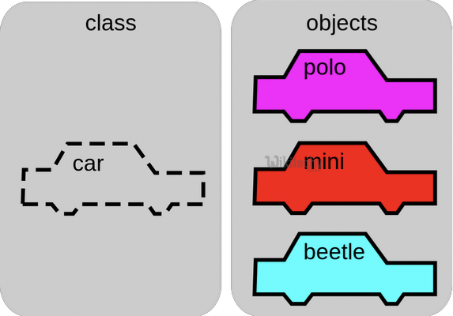
Variables, Objects, and Classes (cont.)
A class is a collection of objects who share the same set of variables/methods.
The definition of the class provides a blueprint for all the objects within it (instances).
Instances may share the same variables (color, size, shape, etc.), but they do NOT share the same values for each variable (blue/red/pink, small/large, square/circular etc.)
Instance #1
Color: Pink
Name: Polo
Instance #2
Color: Red
Name: Mini
Instance #3
Color: Blue
Name: Beetle

Slide 18

Basic Syntax Rules
The name of your variable (myInt etc.) is placed on the left of the “=“ operator.
Most variable names are in camel case where the first word begins with a lowercase letter and any subsequent words are capitalized
Variable names may also appear in snake case where all words are lowercase, with underscores between words
The assignment operator (“=“) sets the variable name equal to the memory location where your value is found.
The value of your variable (“Hello, World”) is placed on the right of the “=“ operator.
The type of this value does NOT need to be stated but its format must abide by a given object type (as shown).
myString = “Hello, World” myInt = 7 myFloat = 7.0 myList = [7, 8, 9] myBoolean = true

Slide 19

Basic Syntax Rules
Function Syntax
def...: indicates that you are defining a new function.
function() refers to the name of your function. By convention, this name is typically lowercase and represents a verb/action.
a,b refers to parameters (values or variables) that can be used within the statements of your function’s definition (......). If your function has no parameters, an empty parenthetical () is used.
The return statement is an optional statement that will return a value for your function to your original call.
def function(a, b):
......
return a + b

Slide 20

Basic Syntax Rules (cont.)
Calling a function
Call the function by referring to its name (function()) and by placing any necessary arguments (1, 2) within the parenthesis separated by commas. myValue = function(1, 2)
If you wish, you can set your function call equal to a variable (myValue). The value returned by the function will be assigned to your variable name.
myValue = function(1, 2)

Slide 21
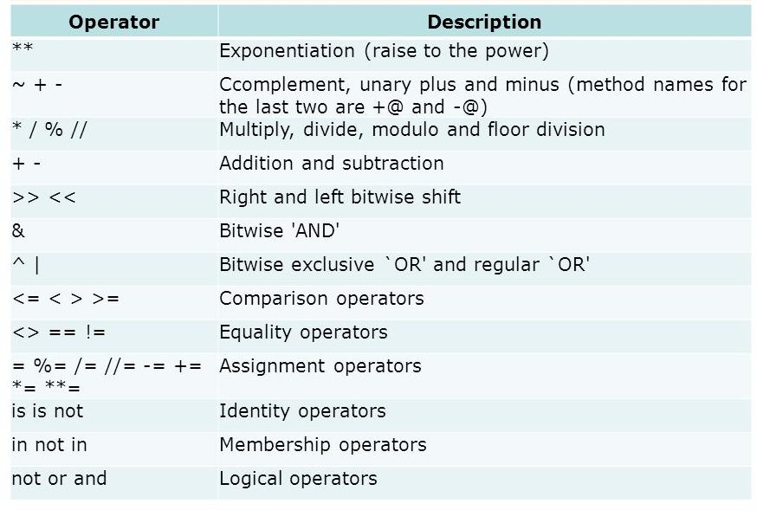
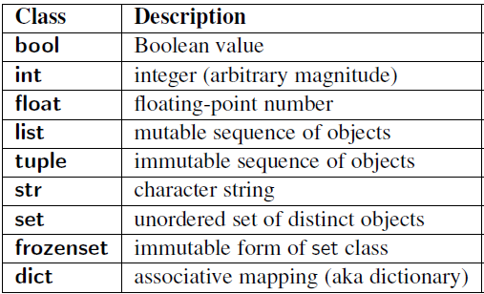
Common Data Types and Operators
A data type is a means of classifying a value and determining what operations can be performed on it. All objects have a data type.
Operators are symbols used carry out specific functions/computations.
https://www.youtube.com/watch?v=v5MR5JnKcZI

Slide 22

Input/Output
Input functions (input()) allow users of a program to place values into programming code.
The parameter for an input function is called a prompt. This is a string (this can be indicated by “” or ‘’) such as “Enter a number: “
The user’s response to the prompt will be returned to the input statement call as a string. To use this value as any other data type, it must be converted with another function (int()).
Print functions (print()) allow programs to output strings to users on a given interface.
The parameter of this function is of any type. All types will automatically be converted to strings.
xString = input(“Enter a number: “)
x = int(xString) y=x+2 print(y)

Slide 23

If-else Statements
If-else statements allow programmers to adapt the function of their code based on a given condition.
If a given condition (i.e. x % 2 == 0) is true, then the statements following the if statement (if) will be executed. If the condition is false, the statements following the else statement (else) will be executed.
The condition is tested using the Boolean operators == (is equal to), != (is not equal to), and (used to test multiple conditions), and or (used to test if AT LEAST ONE condition is true).
Additionally, else-if statements (elif) can be used to provide unique coding statements for multiple conditions.
xString = input(“Enter a number: “)
x = int(xString)
if x % 2 == 0: print(“This is an even number”)
elif x == 0: print(“This number equals 0”)
else:
print(“This is an odd number”)

Slide 24

For Loops
For loops perform the same task (iterate) for the number of times specified by an iterable (something that can be evaluated repeatedly such as a list, string, or range).
for defines the for loop
x is the variable defining the number of times the statements within the loop (print(myInt)) are executed.
The range(start, stop, step) function is often used to define x.
The starting value is defined by start, the final value is defined by stop – 1, and the magnitude at which x changes between loops is defined by step.
in is a Boolean operator that returns true if the given value (x) is found within a given list, string, range etc.
myString = input(“Enter a number: “)
myInt = int(myString)
for x in range(0, 5, 1): print(myInt)

Slide 25

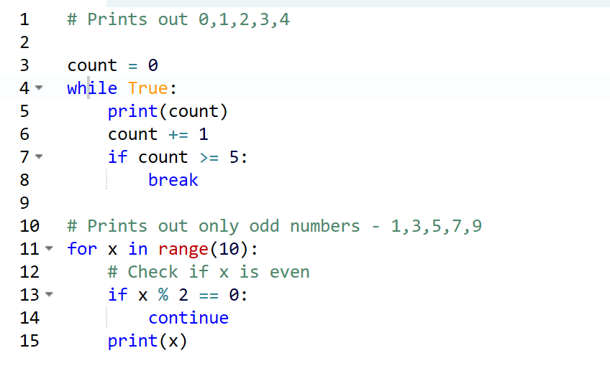
While Loops
myString = input(“Enter a number: “)
myInt = int(myString)
x = 0 while x < 5:
print(myInt)
x= x +1
While loops are statements that iterate so long as a given Boolean condition is met.
x (the variable determining whether or not the condition is met) is defined and manipulated OUTSIDE of the header of the while loop (while)
The condition (x < 5) is a statement containing a Boolean variable.
break is a statement used to exit the current for/while loop.
continue is a statement used to reject all statements in the current for/while loop iteration and return to the beginning of the loop.

Slide 26
The Python Interpreter
Typical Python implementations offer both an interpreter and compiler.
Interactive interface to Python with a read-eval-print loop
>>> def square(x):
... return x * x
...
>>> map(square, [1, 2, 3, 4])
[1, 4, 9, 16]
>>>

Slide 27
Installing
Python is pre-installed on most Unix systems, including Linux and MAC OS X
The pre-installed version may not be the most recent one (2.6.2 and 3.1.1 as of Sept 09)
Download from http://python.org/download/
Python comes with a large library of standard modules
There are several options for an IDE
IDLE – works well with Windows
Emacs with python-mode or your favorite text editor
Eclipse with Pydev (http://pydev.sourceforge.net/)

Slide 28
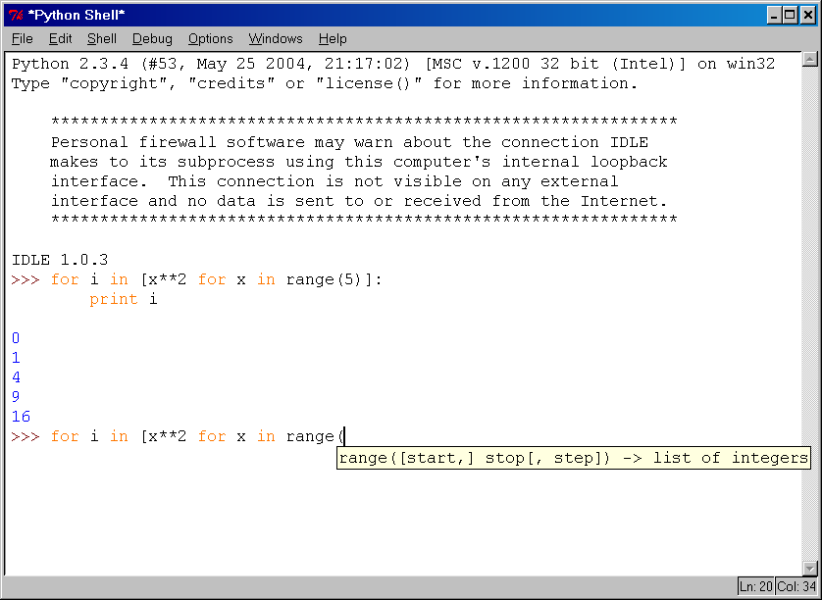
IDLE Development Environment
IDLE is an Integrated DeveLopment Environ-ment for Python, typically used on Windows
Multi-window text editor with syntax highlighting, auto-completion, smart indent and other.
Python shell with syntax highlighting.
Integrated debugger with stepping, persis- tent breakpoints, and call stack visi- bility

Slide 29
Python Scripts
When you call a python program from the command line the interpreter evaluates each expression in the file
Familiar mechanisms are used to provide command line arguments and/or redirect input and output
Python also has mechanisms to allow a python program to act both as a script and as a module to be imported and used by another python program

Slide 30
The Basics

Slide 31
A Code Sample (in IDLE)
x = 34 - 23 # A comment.
y = “Hello” # Another one.
z = 3.45
if z == 3.45 or y == “Hello”:
x = x + 1
y = y + “ World” # String concat.
print x
print y

Slide 32
Enough to Understand the Code
Indentation matters to code meaning
Block structure indicated by indentation
First assignment to a variable creates it
Variable types don’t need to be declared.
Python figures out the variable types on its own.
Assignment is = and comparison is ==
For numbers + - * / % are as expected
Special use of + for string concatenation and % for string formatting (as in C’s printf)
Logical operators are words (and, or, not) not symbols
The basic printing command is print

Slide 33
Basic Datatypes
Integers (default for numbers)
z = 5 / 2 # Answer 2, integer division
Floats
x = 3.456
Strings
Can use “” or ‘’ to specify with “abc” == ‘abc’
Unmatched can occur within the string: “matt’s”
Use triple double-quotes for multi-line strings or strings than contain both ‘ and “ inside of them: “““a‘b“c”””

Slide 34
Whitespace
Whitespace is meaningful in Python: especially indentation and placement of newlines
Use a newline to end a line of code
Use \ when must go to next line prematurely
No braces {} to mark blocks of code, use consistent indentation instead
First line with less indentation is outside of the block
First line with more indentation starts a nested block
Colons start of a new block in many constructs, e.g. function definitions, then clauses

Slide 35
Comments
Start comments with #, rest of line is ignored
Can include a “documentation string” as the first line of a new function or class you define
Development environments, debugger, and other tools use it: it’s good style to include one
def fact(n):
“““fact(n) assumes n is a positive integer and returns facorial of n.””” assert(n>0)
return 1 if n==1 else n*fact(n-1)

Slide 36
Assignment
Binding a variable in Python means setting a name to hold a reference to some object
Assignment creates references, not copies
Names in Python do not have an intrinsic type, objects have types
Python determines the type of the reference automatically based on what data is assigned to it
You create a name the first time it appears on the left side of an assignment expression: x = 3
A reference is deleted via garbage collection after any names bound to it have passed out of scope
Python uses reference semantics (more later)

Slide 37
Naming Rules
Names are case sensitive and cannot start with a number. They can contain letters, numbers, and underscores.
bob Bob _bob _2_bob_ bob_2 BoB
There are some reserved words:
and, assert, break, class, continue, def, del, elif, else, except, exec, finally, for, from, global, if, import, in, is, lambda, not, or, pass, print, raise, return, try, while

Slide 38
Keyword | Purpose/Usage Description
and | Logical operator used to combine conditional statements.
assert | Used for debugging, tests a condition and raises an AssertionError if false.
break | Exits the nearest enclosing loop prematurely.
class | Defines a new user-defined class.
continue | Skips the rest of the loop iteration and moves to the next iteration.
def | Defines a new function.
del | Deletes a reference to an object (like a variable, list element, etc.).
elif | Stands for "else if", used in conditional branching.
else | Specifies a block of code to execute if the condition is false.
except | Catches and handles exceptions in a try block.
exec | Executes dynamically created Python code (Python 2 only, replaced by exec() in Python 3).
finally | Defines a block of code that will always execute, after try and except.

Slide 39
for | Starts a for loop, used to iterate over a sequence.
from | Used with import to import specific parts of a module.
global | Declares a variable as global (i.e., accessible at the module level).
if | Starts a conditional block.
import | Imports a module or specific attributes from a module.
in | Checks if a value exists in a sequence (also used in for loops).
is | Tests object identity (i.e., whether two variables point to the same object).
lambda | Creates an anonymous function.
not | Logical negation operator.
or | Logical operator used to combine conditional statements.
pass | Placeholder that does nothing, used when a statement is syntactically required.
print | Outputs text to the console (function in Python 3, statement in Python 2).
raise | Raises an exception.
return | Exits a function and optionally returns a value.
try | Specifies exception handling block.
while | Starts a while loop, executes as long as a condition is true.

Slide 40
Assignment
You can assign to multiple names at the same time
>>> x, y = 2, 3
>>> x
2
>>> y
3
This makes it easy to swap values
>>> x, y = y, x
Assignments can be chained
>>> a = b = x = 2

Slide 41
Sequence types: Tuples, Lists, and Strings

Slide 42
Sequence Types
Tuple: (‘john’, 32, [CMSC])
A simple immutable ordered sequence of items
Items can be of mixed types, including collection types
Strings: “John Smith”
Immutable
Conceptually very much like a tuple
List: [1, 2, ‘john’, (‘up’, ‘down’)]
Mutable ordered sequence of items of mixed types

Slide 43
Similar Syntax
All three sequence types (tuples, strings, and lists) share much of the same syntax and functionality.
Key difference:
Tuples and strings are immutable
Lists are mutable
The operations shown in this section can be applied to all sequence types
most examples will just show the operation performed on one

Slide 44
Sequence Types 1
Define tuples using parentheses and commas
>>> tu = (23, ‘abc’, 4.56, (2,3), ‘def’)
Define lists are using square brackets and commas
>>> li = [“abc”, 34, 4.34, 23]
Define strings using quotes (“, ‘, or “““).
>>> st = “Hello World”
>>> st = ‘Hello World’
>>> st = “““This is a multi-line
string that uses triple quotes.”””

Slide 45
Sequence Types 2
Access individual members of a tuple, list, or string using square bracket “array” notation
Note that all are 0 based…
>>> tu = (23, ‘abc’, 4.56, (2,3), ‘def’)
>>> tu[1] # Second item in the tuple.
‘abc’
>>> li = [“abc”, 34, 4.34, 23]
>>> li[1] # Second item in the list.
34
>>> st = “Hello World”
>>> st[1] # Second character in string.
‘e’

Slide 46
Positive and negative indices
>>> t = (23, ‘abc’, 4.56, (2,3), ‘def’)
Positive index: count from the left, starting with 0
>>> t[1]
‘abc’
Negative index: count from right, starting with –1
>>> t[-3]
4.56

Slide 47
Slicing: return copy of a subset
>>> t = (23, ‘abc’, 4.56, (2,3), ‘def’)
Return a copy of the container with a subset of the original members. Start copying at the first index, and stop copying before second.
>>> t[1:4]
(‘abc’, 4.56, (2,3))
Negative indices count from end
>>> t[1:-1]
(‘abc’, 4.56, (2,3))

Slide 48
Slicing: return copy of a =subset
>>> t = (23, ‘abc’, 4.56, (2,3), ‘def’)
Omit first index to make copy starting from beginning of the container
>>> t[:2]
(23, ‘abc’)
Omit second index to make copy starting at first index and going to end
>>> t[2:]
(4.56, (2,3), ‘def’)

Slide 49
Copying the Whole Sequence
[ : ] makes a copy of an entire sequence
>>> t[:]
(23, ‘abc’, 4.56, (2,3), ‘def’)
Note the difference between these two lines for mutable sequences
>>> l2 = l1 # Both refer to 1 ref,
# changing one affects both
>>> l2 = l1[:] # Independent copies, two refs

Slide 50
The ‘in’ Operator
Boolean test whether a value is inside a container:
>>> t = [1, 2, 4, 5]
>>> 3 in t
False
>>> 4 in t
True
>>> 4 not in t
False
For strings, tests for substrings
>>> a = 'abcde'
>>> 'c' in a
True
>>> 'cd' in a
True
>>> 'ac' in a
False
Be careful: the in keyword is also used in the syntax of for loops and list comprehensions

Slide 51
The + Operator
The + operator produces a new tuple, list, or string whose value is the concatenation of its arguments.
>>> (1, 2, 3) + (4, 5, 6)
(1, 2, 3, 4, 5, 6)
>>> [1, 2, 3] + [4, 5, 6]
[1, 2, 3, 4, 5, 6]
>>> “Hello” + “ ” + “World”
‘Hello World’

Slide 52
The * Operator
The * operator produces a new tuple, list, or string that “repeats” the original content.
>>> (1, 2, 3) * 3
(1, 2, 3, 1, 2, 3, 1, 2, 3)
>>> [1, 2, 3] * 3
[1, 2, 3, 1, 2, 3, 1, 2, 3]
>>> “Hello” * 3
‘HelloHelloHello’

Slide 53
Mutability: Tuples vs. Lists

Slide 54
Lists are mutable
>>> li = [‘abc’, 23, 4.34, 23]
>>> li[1] = 45
>>> li [‘abc’, 45, 4.34, 23]
We can change lists in place.
Name li still points to the same memory reference when we’re done.

Slide 55
Tuples are immutable
>>> t = (23, ‘abc’, 4.56, (2,3), ‘def’)
>>> t[2] = 3.14
Traceback (most recent call last):
File "<pyshell#75>", line 1, in -toplevel-
tu[2] = 3.14
TypeError: object doesn't support item assignment
You can’t change a tuple.
You can make a fresh tuple and assign its reference to a previously used name.
>>> t = (23, ‘abc’, 3.14, (2,3), ‘def’)
The immutability of tuples means they’re faster than lists.

Slide 56
Operations on Lists Only
>>> li = [1, 11, 3, 4, 5]
>>> li.append(‘a’) # Note the method syntax
>>> li
[1, 11, 3, 4, 5, ‘a’]
>>> li.insert(2, ‘i’)
>>>li
[1, 11, ‘i’, 3, 4, 5, ‘a’]

Slide 57
The extend method vs +
+ creates a fresh list with a new memory ref
extend operates on list li in place.
>>> li.extend([9, 8, 7])
>>> li
[1, 2, ‘i’, 3, 4, 5, ‘a’, 9, 8, 7]
Potentially confusing:
extend takes a list as an argument.
append takes a singleton as an argument.
>>> li.append([10, 11, 12])
>>> li
[1, 2, ‘i’, 3, 4, 5, ‘a’, 9, 8, 7, [10, 11, 12]]

Slide 58
Operations on Lists Only
Lists have many methods, including index, count, remove, reverse, sort
>>> li = [‘a’, ‘b’, ‘c’, ‘b’]
>>> li.index(‘b’) # index of 1st occurrence
1
>>> li.count(‘b’) # number of occurrences
2
>>> li.remove(‘b’) # remove 1st occurrence
>>> li
[‘a’, ‘c’, ‘b’]

Slide 59
Operations on Lists Only
>>> li = [5, 2, 6, 8]
>>> li.reverse() # reverse the list *in place*
>>> li
[8, 6, 2, 5]
>>> li.sort() # sort the list *in place*
>>> li
[2, 5, 6, 8]
>>> li.sort(some_function)
# sort in place using user-defined comparison

Slide 60
Tuple details
The comma is the tuple creation operator, not parens
>>> 1,
(1,)
Python shows parens for clarity (best practice)
>>> (1,)
(1,)
Don't forget the comma!
>>> (1)
1
Trailing comma only required for singletons others
Empty tuples have a special syntactic form
>>> ()
()
>>> tuple()
()

Slide 61
Python + SQL Integration
SQL (Structured Query Language) is a standardized programming language specifically designed for managing and manipulating relational databases.
It allows users to interact with databases to perform various operations, such as querying data, updating records, creating and modifying database structures, and controlling access to data.

Slide 62
What is a Database Schema?
A schema defines the structure of a database, including tables, fields, data types, and relationships.

Slide 63
Understanding Database Schemas in Python SQL Libraries
What Is a Database Schema?
A database schema is a blueprint or architecture of how the database is structured. It defines:
Tables
Fields (columns)
Data types
Relationships (e.g., one-to-many)
Indexes and constraints

Slide 64
Core Features of SQL
Data Definition (DDL)Commands: CREATE, ALTER, DROP
CREATE TABLE employees (
id INT PRIMARY KEY,
name VARCHAR(100),
age INT,
department VARCHAR(50)
);
Data Querying: Use the SELECT statement to retrieve data from one or more tables
SELECT name, age FROM employees WHERE department = 'Sales’;
Data Manipulation (DML)Commands: INSERT, UPDATE, DELETE
INSERT INTO employees (name, age, department) VALUES ('Alice', 30, 'HR’);

Slide 65
Data Control Language (DCL)
DCL commands manage access permissions and security for the database objects.
1. GRANT
Purpose: Assigns specific privileges to users or roles.
Example:
GRANT SELECT, INSERT ON employees TO john;
This gives user john permission to perform SELECT and INSERT operations on the employees table.
2. REVOKE
Purpose: Removes previously granted privileges.
Example:
REVOKE INSERT ON employees FROM john;
This removes the INSERT privilege on the employees table from user john.

Slide 66
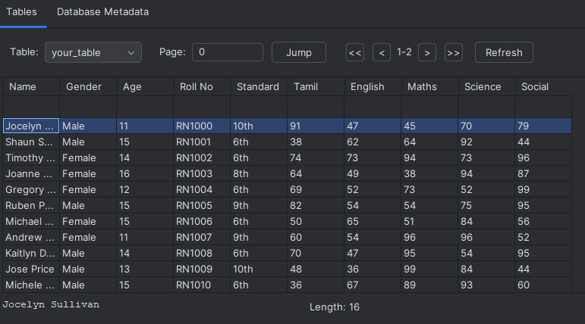
Users Table
Purpose: Stores user details such as name, age, gender, and nationality.

Slide 67

Users Table Fields
id (PK), name (TEXT), age (INTEGER), gender (TEXT), nationality (TEXT)

Slide 68
Users Table - SQLAlchemy Model
class User(Base):
__tablename__ = 'users'
id = Column(Integer, primary_key=True)
name = Column(String)
age = Column(Integer)
gender = Column(String)
nationality = Column(String)

Slide 69
Posts Table - SQLAlchemy Model
class Post(Base):
__tablename__ = 'posts'
id = Column(Integer, primary_key=True)
title = Column(String)
description = Column(String)
user_id = Column(Integer, ForeignKey('users.id'))

Slide 70
Comments Table - SQLAlchemy Model
class Comment(Base):
__tablename__ = 'comments'
id = Column(Integer, primary_key=True)
text = Column(String)
user_id = Column(Integer, ForeignKey('users.id'))
post_id = Column(Integer, ForeignKey('posts.id'))

Slide 72
THANK YOU

Slide 73
